Slide 1

HOSTEL MANAGEMENT SYSTEM
Guided By: Presented By:
Dr. Mukesh Rawat Anshika Gupta
Mr. Rohit Agarwal Gudiya Singh
Dept. Of CSE Aashu Sharma

Slide 2
CONTENTS
Introduction
Objectives
Existing System
Proposed System
System Environment
Modules In HMS
Conclusion

Slide 3
Introduction
Hostel Management System (HMS) is web-based
system for managing various activities in the hostel
It helps in avoiding the problems which occur when carried out manually
It improves the efficiency of the system
HMS is supposed to manage following activities –
●Room Allotment
●Complaints management
●Recent activities
●Facilities management and many more

Slide 4
OBJECTIVES
To automate each and every activity of the manual
system, which increases its throughput
To provide a quick response with very accurate
information as and when required
To make the present manual system more
interactive, speedy and user friendly
To avail any information, whatever and whenever
needed
Reduce the cost of maintenance

Slide 5
EXISTING SYSTEM
The existing system is a manually maintained system
It involves hand-written records
Requires a lot of time as well as manpower
It is very difficult to maintain or update all the
records and retrieve a certain data
The loss or damage of any of the registers leads to the damage of hundreds of records at a time
Reports need to be generated manually

Slide 6
ADVANTAGES OF PROPOSED SYSTEM
Less human error
Strength and strain of manual labour can be
reduced
High security
Data redundancy can be avoided to some extent
Data consistency
Easy to handle complaints
Easy to manage hostel committees events
Easy record keeping

Slide 7
MODULES IN HMS
Admin module
Student module
Facilities
Recent Activities
Complaints
Hostel Committees
Feedback

Slide 8
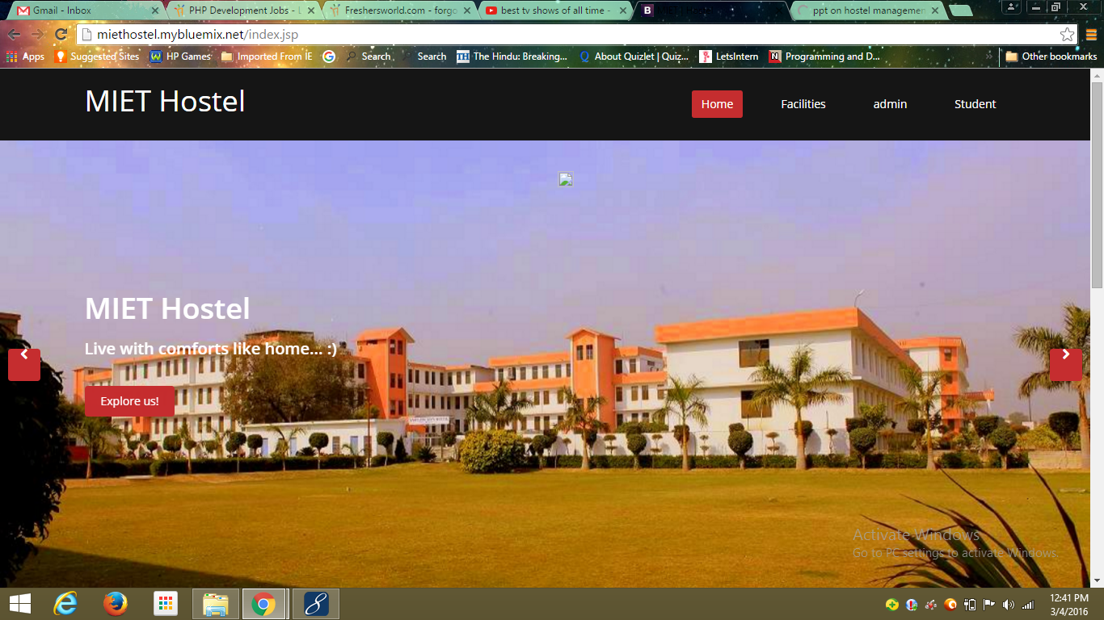
Hostel management system

Slide 9
Admin Module
This module is managed by the administrator
The admin can do the following tasks–
view student record by name
view hostel records by room type
view the roomwise information
send alerts to all students
manage complaints(complete and uncomplete)

Slide 10
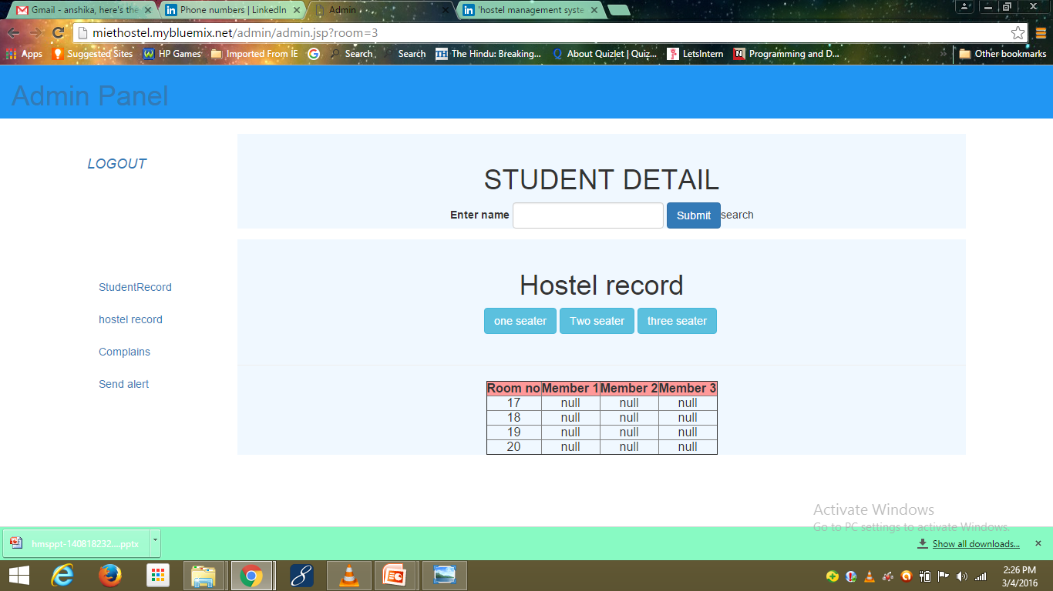
ADMIN DASHBOARD

Slide 11
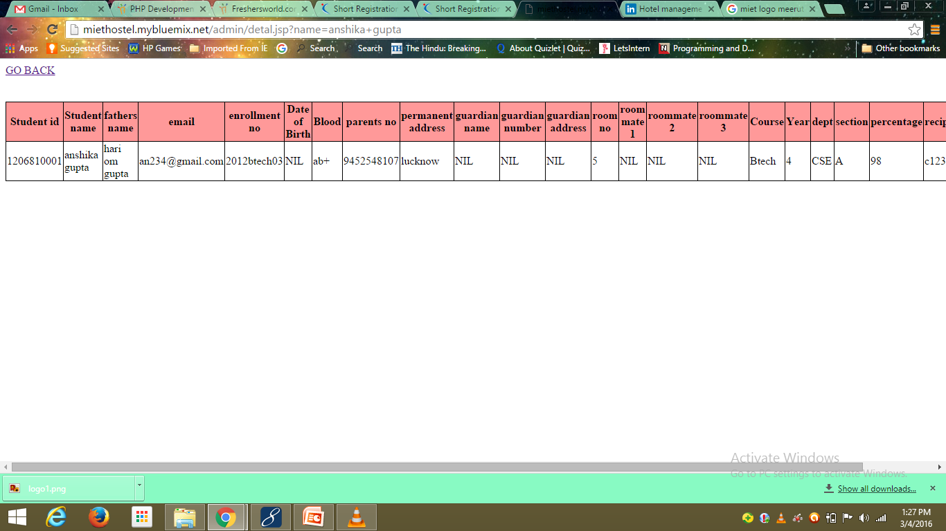
View Student Record

Slide 12
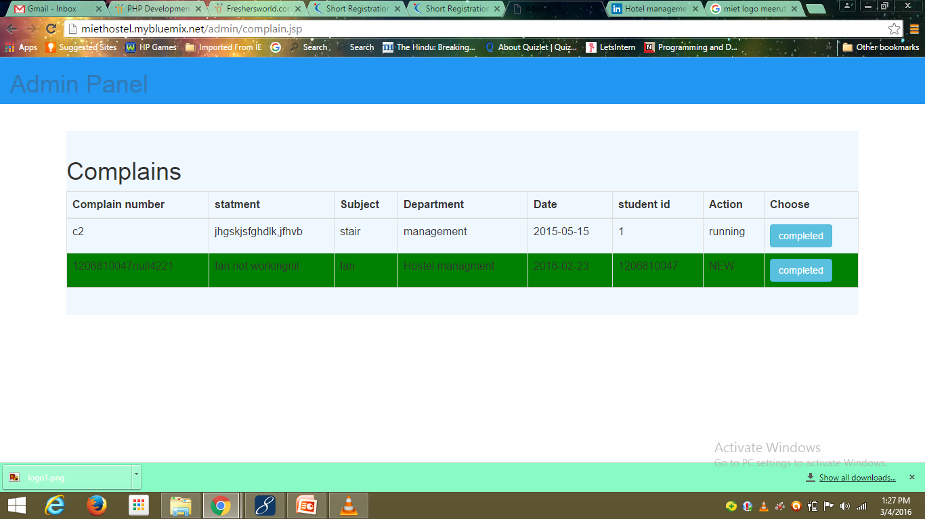
Register Complain

Slide 13
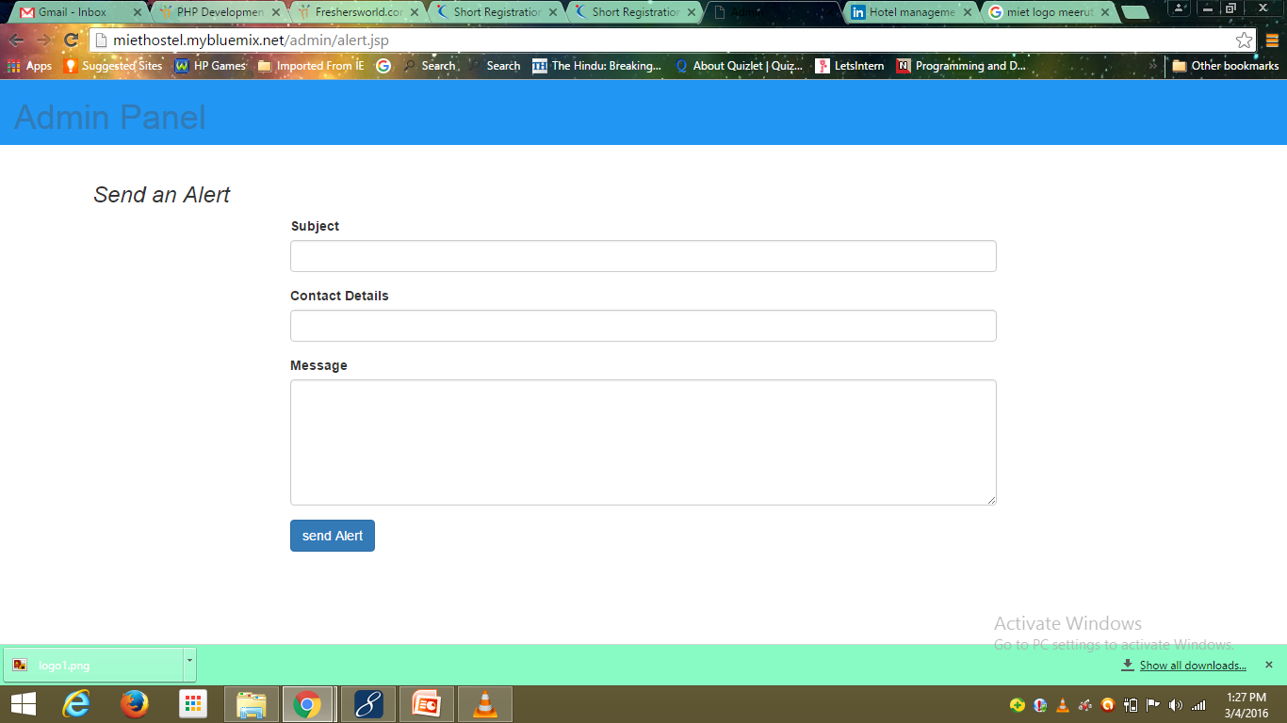
Can Send Alert

Slide 14
STUDENT MODULE
It consists of two components –
Student Register
Student Login
Student Register –
you have to fill three forms –
-- Personal information
--Contact details
--Academic details
Now the “room selection” is enabled. You can now proceed further
Registration is done only after mail verification.

Slide 15
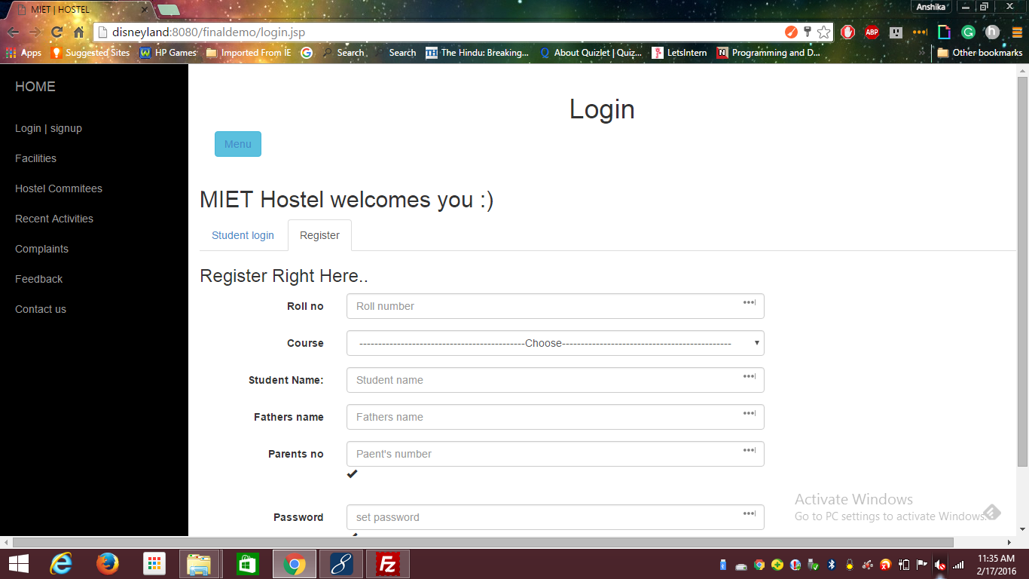
Student Register

Slide 16
STUDENT MODULE CONTINUE…
Student Login –
One can now register for complaints
Can register for events
Can view and modify his information except some information
Can view all the alerts sent to him by the admin

Slide 17
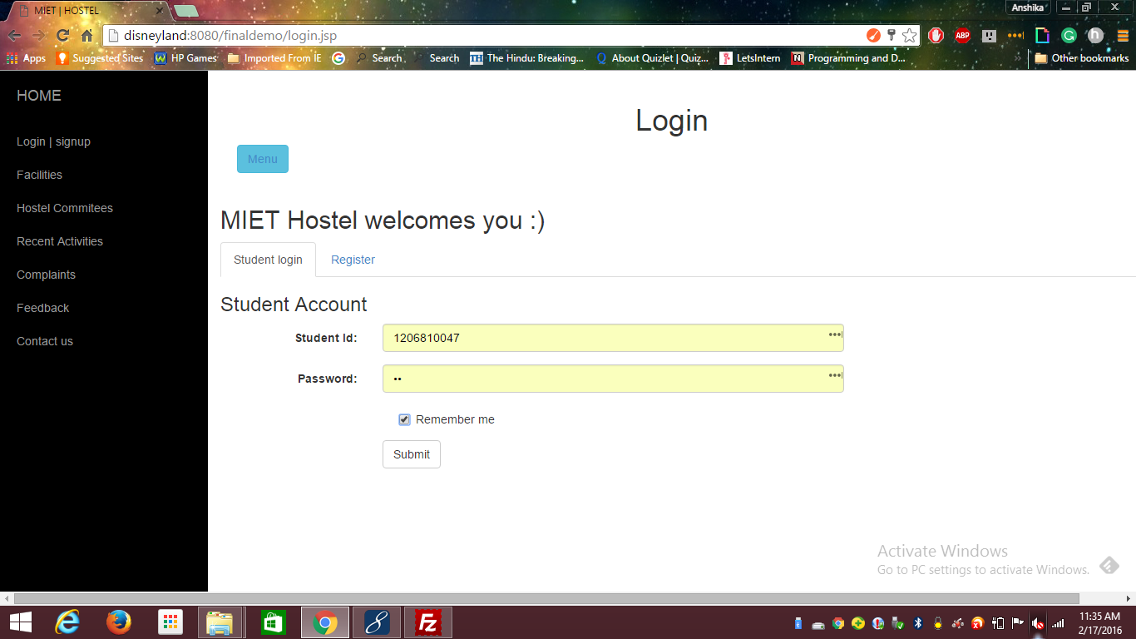
Student login

Slide 18
Complain Management
STUDENT :
A person can register a complain related to water, electricity and many more only when he is logged in otherwise he should first log in , then can register the complaint.
ADMINISTRATOR :
Admin can view all the complaints registered by the users and can fulfill the demands of the students.

Slide 19
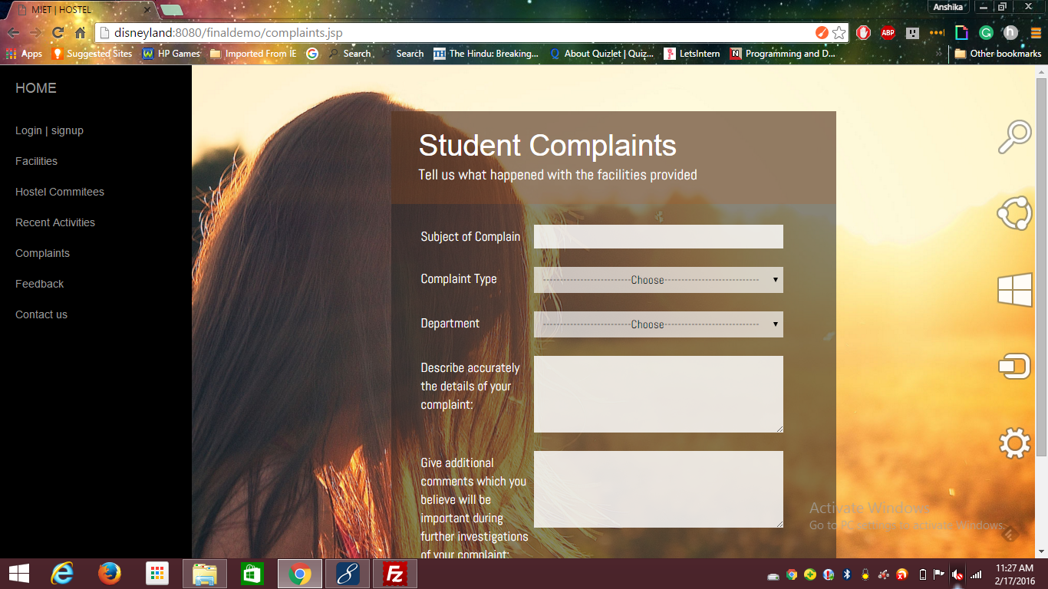
Complain Form

Slide 20
Continue…
Our system allows the user to send the complaint directly to the concerned authority via mail or SMS.
It saves a lot of time for both the user and the administrator.
It also helps us to keep a log so that we can improve our services.

Slide 21
More Features
FACILITIES:
Student can access a no. of facilities and have an access to the information related to different facilities available to him.
COMMITTIEES:
There are various committees in hostel.
Students can keep them updated with the latest things happening in the committee as they have access to all the committee information.

Slide 22
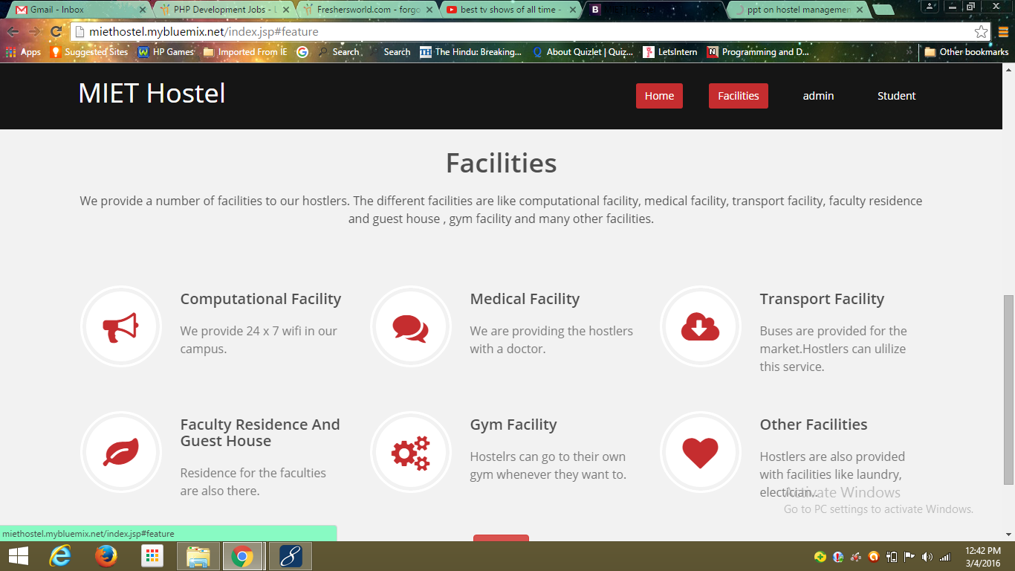
Facilities

Slide 23
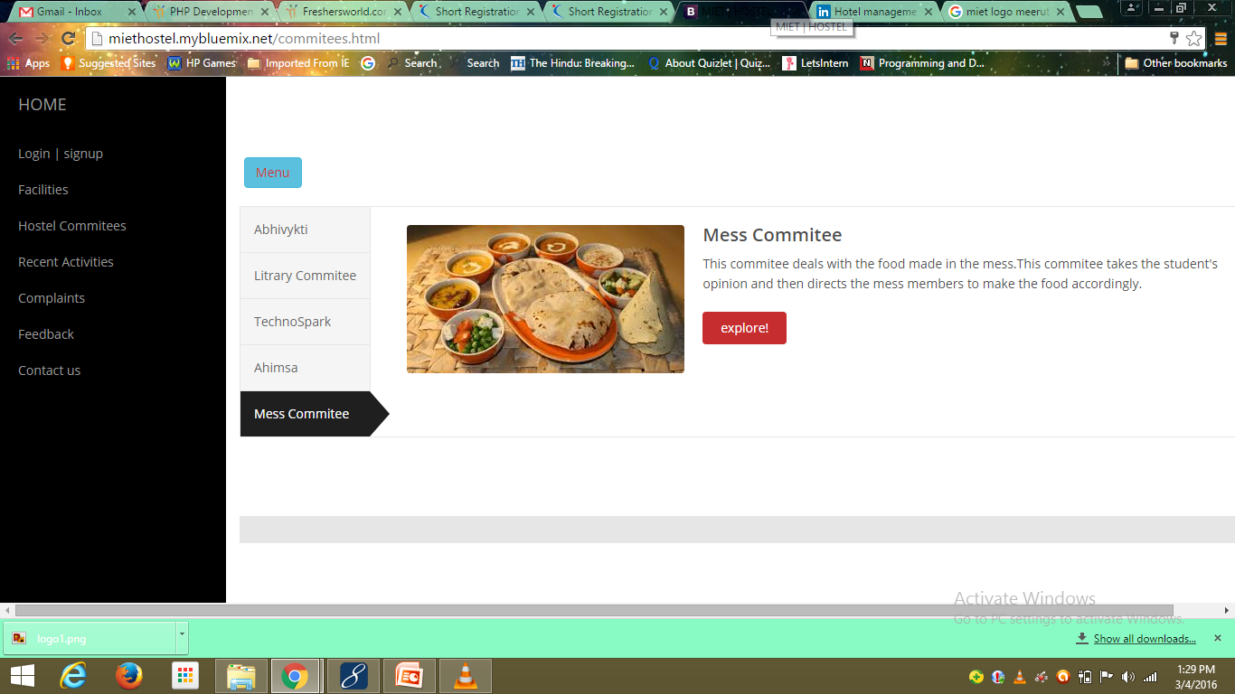
Hostel Committees

Slide 24
Feedback
Students can provide their reviews on various activities that are going on our site so that we can improve them.
It makes our system more interactive and reliable.

Slide 25
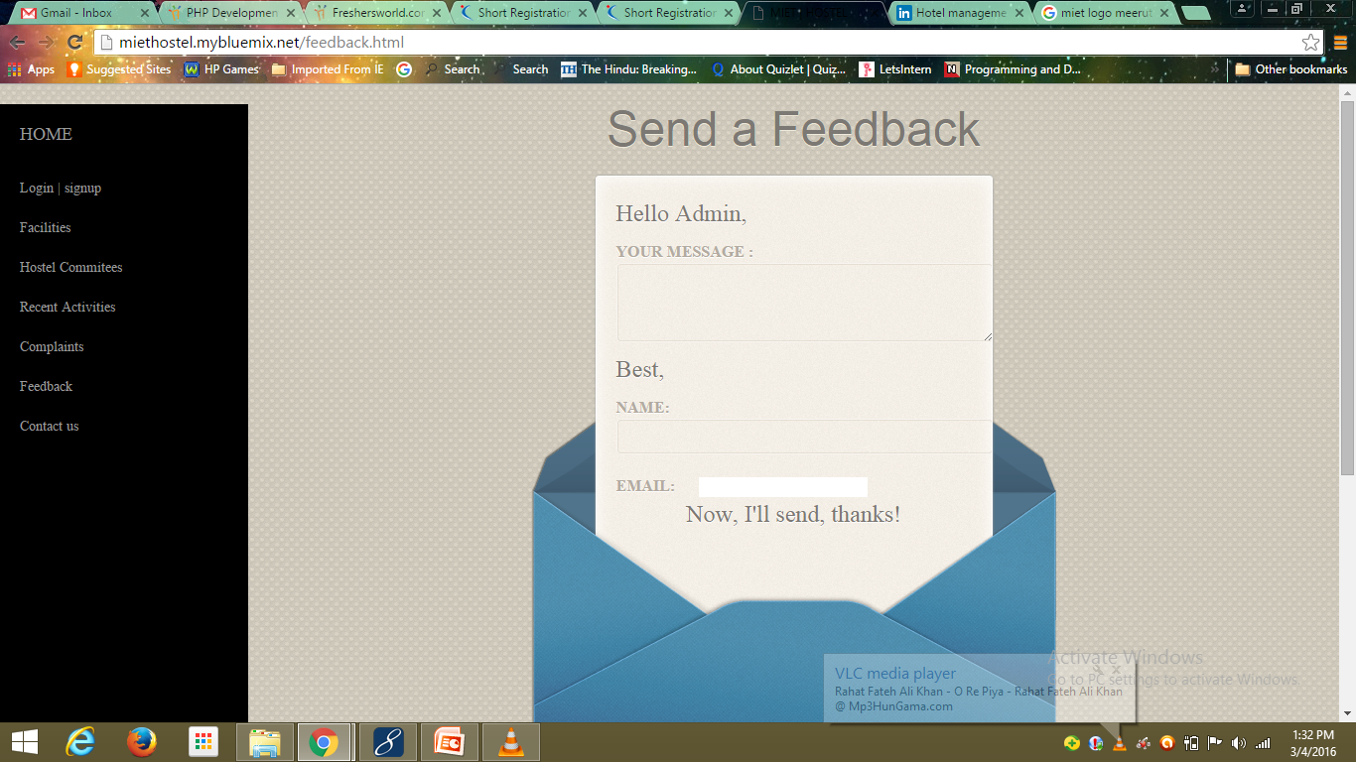
Feedback

Slide 26
CONCLUSION
HMS is a web based system which automates all
the activities in the hostel which is currently manual.
It overcomes the need of maintainance of registers.
Overall efficiency of the system is improved.
User can easily register for various events.
It also automate the working of complaint management i.e . The user can directly send complain via SMS.

Slide 27
THANK YOU

